Slide 1
DRC Standard
Tianxiao

Slide 2
DRC Standard
DRC
Design rule check
Based on our manufacturer
Define minimum distance between components, minimum diameter of holes…
Select right DRC before starting designing PCB layout

Slide 3
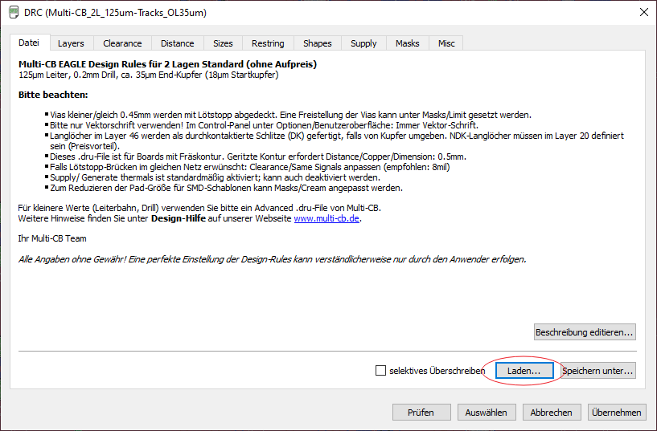

DRC Standard
DRC setting

Slide 4
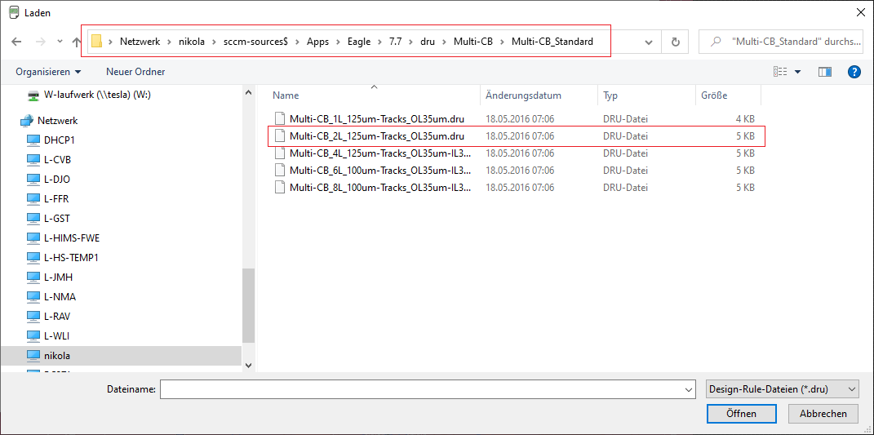
DRC Standard
In DRC setting
Manufacturer Multi-CB
2L board

Slide 5
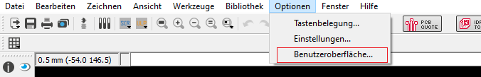
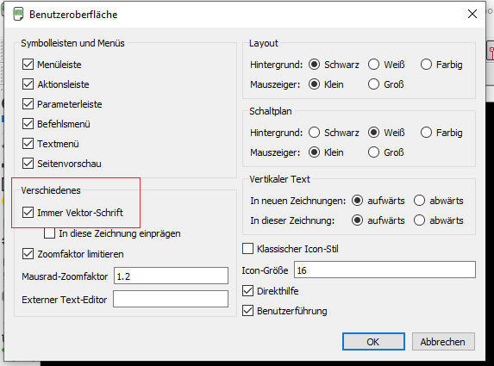
DRC Standard
Always use vectored text
The manufacturer can only print vectored text
The size and position of the text will change after vectorising

Slide 6
DRC Standard
Layer not used for print
20 Dimension
21 tPlace
22 bPlace
27 tValues
28 bValues

